Slide 1
Sampling Distribution of the Mean
Chad Williams
University of Victoria

Slide 2
Lecture Outline
Distributions of Hypothesis Testing
Defining the Sampling Distribution

Slide 3
Lecture Outline
Distributions of Hypothesis Testing
Defining the Sampling Distribution

Slide 4
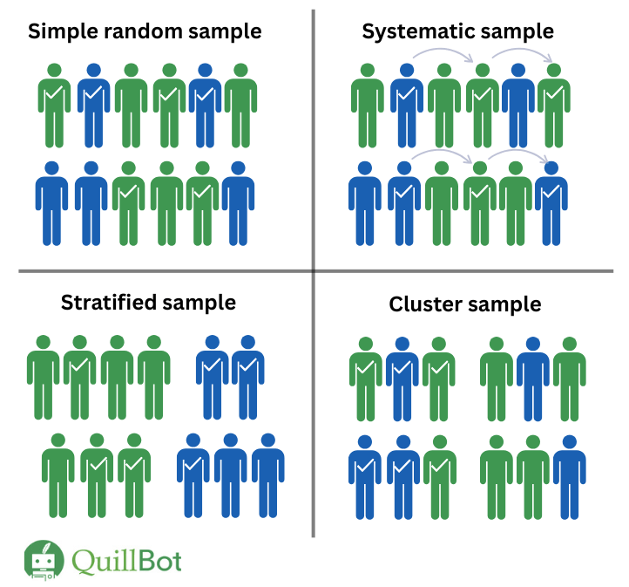
Single Participant versus Single Sample Design
Single-Participant Design: We are comparing a single participant’s score (x) to a distribution of population scores
Does my participant fit this population?
Single-Sample Design: We are comparing a sample’s mean (x̅) to a distribution of possible population means
Does my sample fit this population?

Slide 5
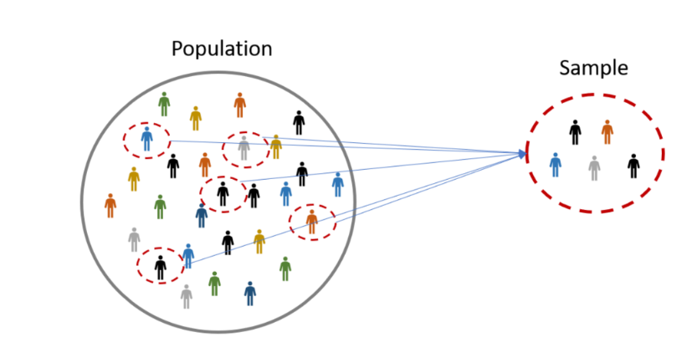
Distributions of Hypothesis Testing
?
Sampling Distribution
Of the Mean

Slide 6
Distribution Symbols
 | Population | Sampling Distribution of the Mean | Sample
Definition | Entire set of data | Distribution of means | Subset of data
Central Tendency | μ | μ_{x̅} | x̅
Variability | σ | σ_{x̅} | SD
Shape | Assumed to be Normal | Normal | Any

Slide 7
Distribution Symbols
 | Population | Sampling Distribution of the Mean | Sample
Definition | Entire set of data | Distribution of means | Subset of data
Central Tendency | μ | μ_{x̅} | x̅
Variability | σ | σ_{x̅} | SD
Shape | Assumed to be Normal | Normal | Any

Slide 8
Distribution Symbols
 | Population | Sampling Distribution of the Mean | Sample
Definition | Entire set of data | Distribution of means | Subset of data
Central Tendency | μ | μ_{x̅} | x̅
Variability | σ | σ_{x̅} | SD
Shape | Assumed to be Normal | Approaches Normal | Any

Slide 9
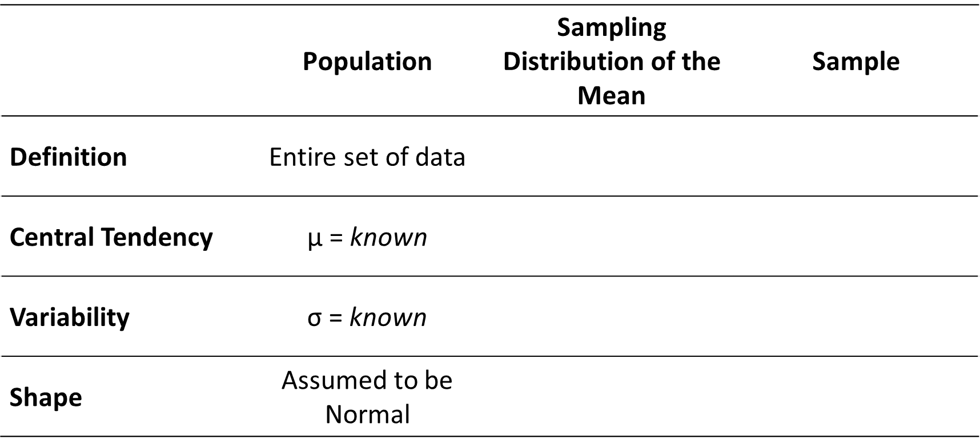
Distribution Equations
 | Population | Sampling Distribution of the Mean | Sample
Definition | Entire set of data | Distribution of means | Subset of data
Central Tendency | μ = known | μ_{x̅} = μ | x̅ = $\frac{∑x}{n}$
Variability | σ = known | σ_{x̅} = $\frac{\text{σ}}{\sqrt{n}}$ | SD = $\sqrt{\frac{∑\left(x−\overline{x}\right)2}{n}}$
Shape | Assumed to be Normal | Normal | Any

Slide 10
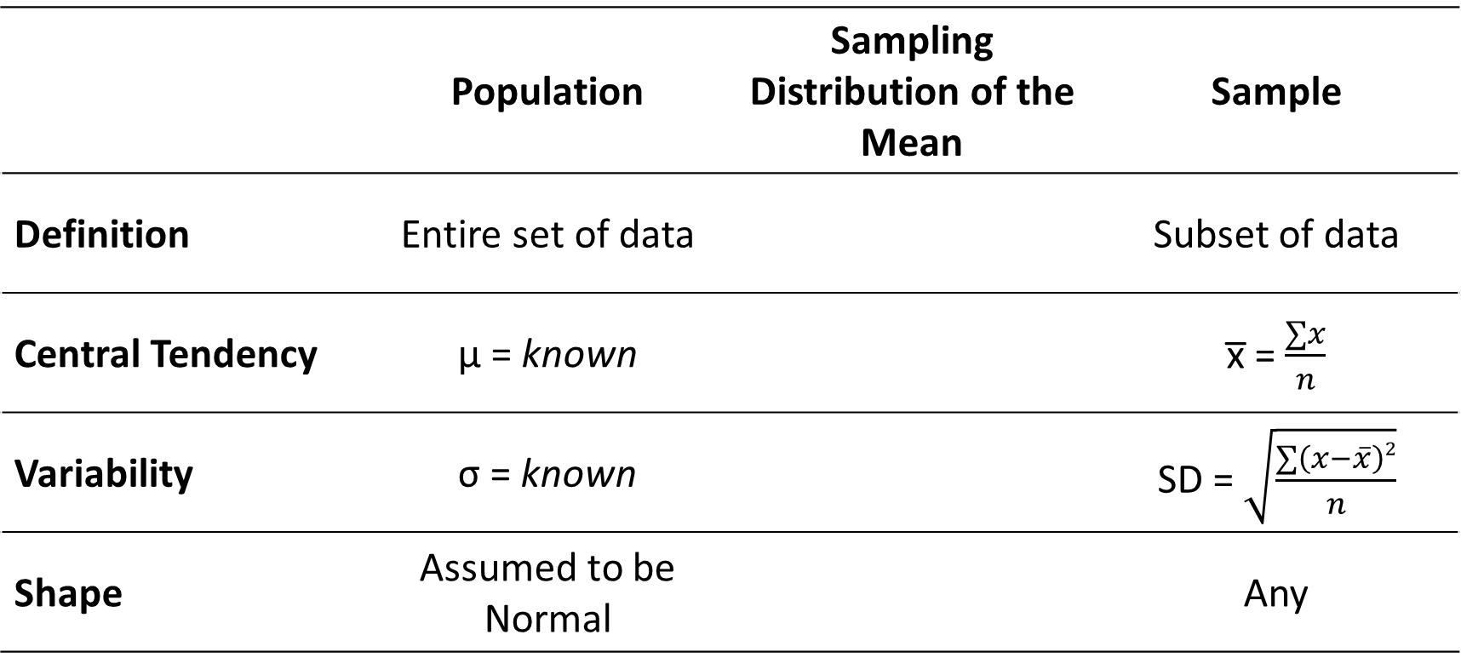
Distribution Equations
 | Population | Sampling Distribution of the Mean | Sample
Definition | Entire set of data | Distribution of means | Subset of data
Central Tendency | μ = known | μ_{x̅} = μ | x̅ = $\frac{∑x}{n}$
Variability | σ = known | σ_{x̅} = $\frac{\text{σ}}{\sqrt{n}}$ | SD = $\sqrt{\frac{∑\left(x−\overline{x}\right)2}{n}}$
Shape | Assumed to be Normal | Normal | Any

Slide 11
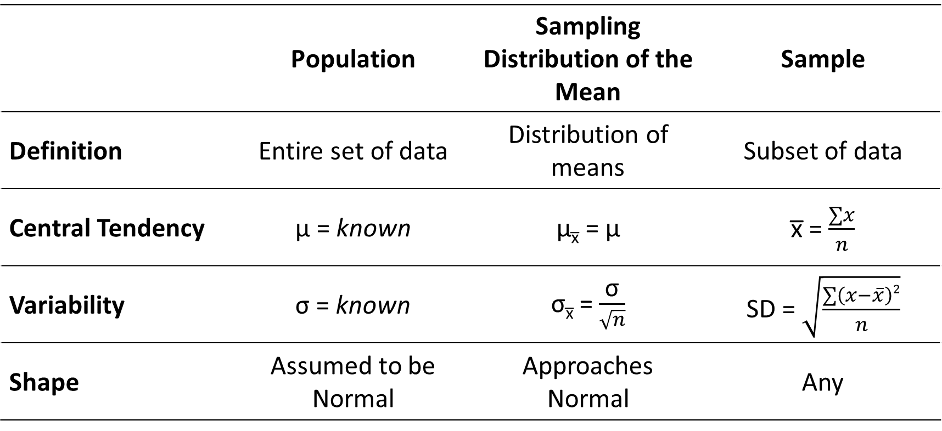
Distribution Equations
 | Population | Sampling Distribution of the Mean | Sample
Definition | Entire set of data | Distribution of means | Subset of data
Central Tendency | μ = known | μ_{x̅} = μ | x̅ = $\frac{∑x}{n}$
Variability | σ = known | σ_{x̅} = $\frac{\text{σ}}{\sqrt{n}}$ | SD = $\sqrt{\frac{∑\left(x−\overline{x}\right)2}{n}}$
Shape | Assumed to be Normal | Approaches Normal | Any

Slide 12
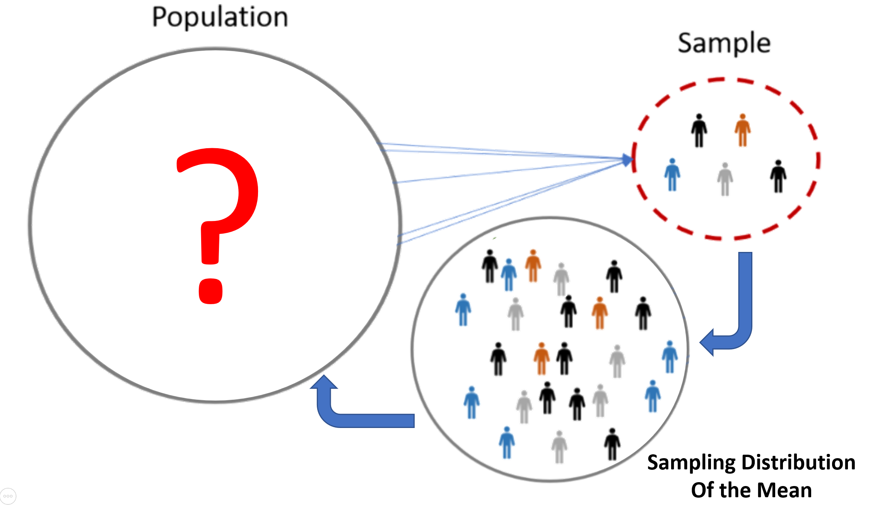
Types of Distributions
Population: An entire set of data trying to be estimated by statistics
Sample: Subset of persons, animals, events, etc. from a given population

Slide 13
Types of Distributions
Sampling Distribution of the Mean
This distribution gives us a range of possible population means and their probabilities
We can also use this to understand the standard deviation of possible population means, which is called standard error
We can then see whether our sample’s mean fits the population’s mean

Slide 14
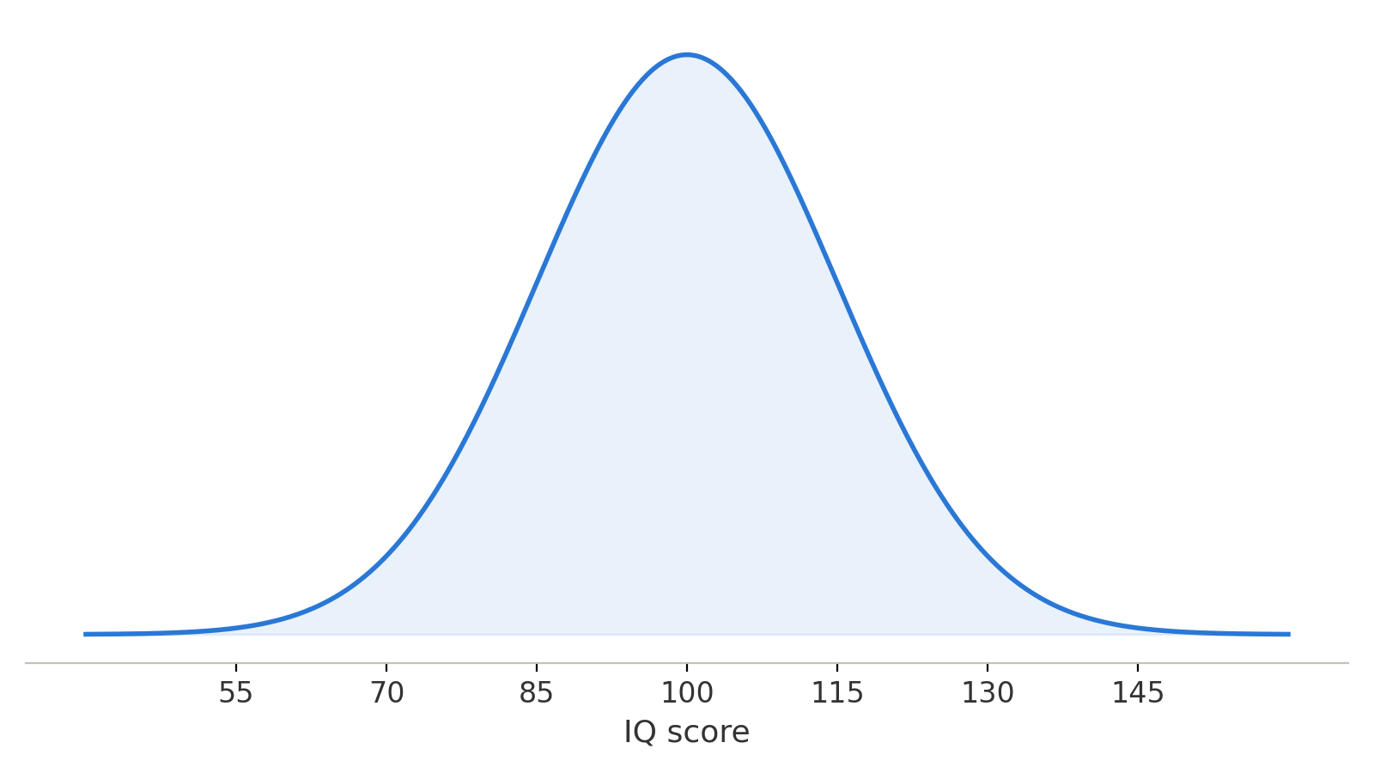
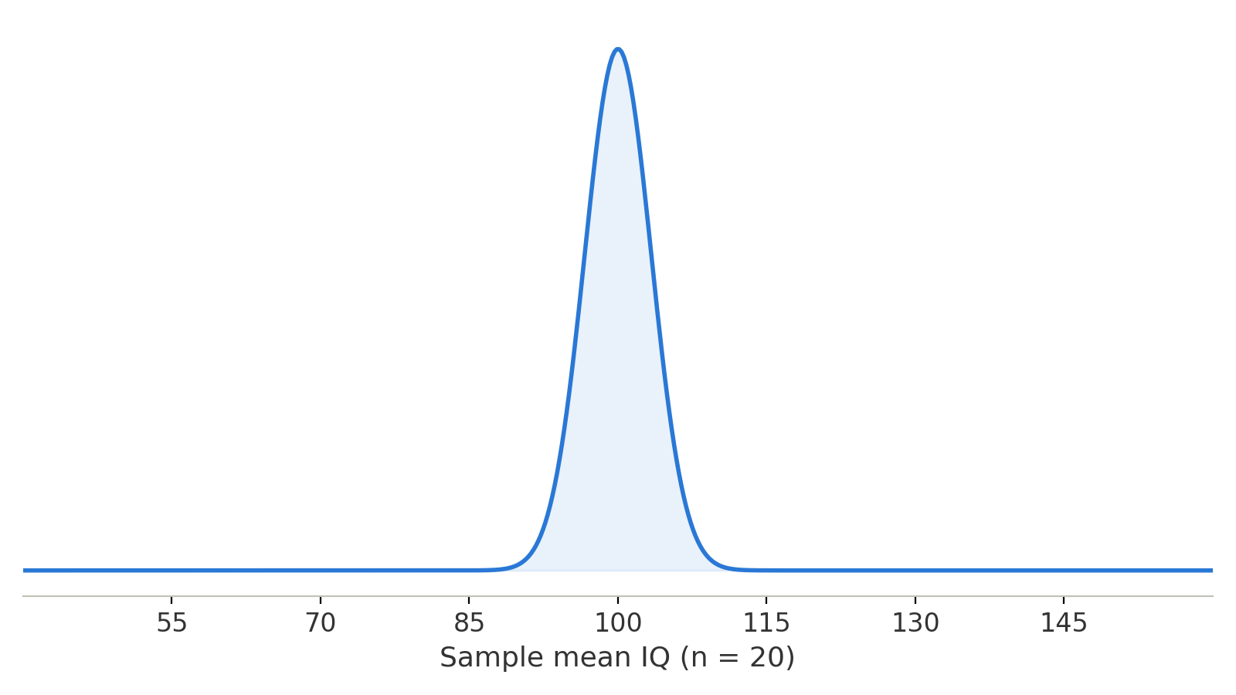
Types of Distributions
Probability distribution of an individual IQ score
Probability distribution of IQ score averages

Slide 15
Types of Distributions
Sampling Distribution of the Mean
A distribution of possible means to estimate population parameters
Specifically, the central tendency, variability, and shape of the population
Depends on sample size (n)
Theoretical or Empirical (matches the population)
Central Tendency: Mean (μ_{x̅})
Variability: Standard error (σ_{x̅})
Shape: Becomes normal with increasing n

Slide 16
Building a Distributions
0 | 1 | -2 | 0
1 | 0 | -1 | 3
-1 | 1 | 2 | -3
0 | -2 | -1 | 2

Slide 17
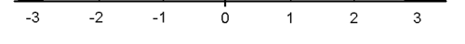
Building a Distributions
0 | 1 | -2 | 0
1 | 0 | -1 | 3
-1 | 1 | 2 | -3
0 | -2 | -1 | 2

Slide 18
Building a Distributions
0 | 1 | -2 | 0
1 | 0 | -1 | 3
-1 | 1 | 2 | -3
0 | -2 | -1 | 2

Slide 19
Building a Distributions
0 | 1 | -2 | 0
1 | 0 | -1 | 3
-1 | 1 | 2 | -3
0 | -2 | -1 | 2

Slide 20
Building a Distributions
0 | 1 | -2 | 0
1 | 0 | -1 | 3
-1 | 1 | 2 | -3
0 | -2 | -1 | 2

Slide 21
Building a Distributions
0 | 1 | -2 | 0
1 | 0 | -1 | 3
-1 | 1 | 2 | -3
0 | -2 | -1 | 2

Slide 22
Building a Sampling Distribution of the Mean
0 | 1 | -2 | 0
1 | 0 | -1 | 3
-1 | 1 | 2 | -3
0 | -2 | -1 | 2
Sampling Distribution of the Mean for n = 2

Slide 23
Building a Sampling Distribution of the Mean
0 | 1 | -2 | 0
1 | 0 | -1 | 3
-1 | 1 | 2 | -3
0 | -2 | -1 | 2
Sampling Distribution of the Mean for n = 2

Slide 24
Building a Sampling Distribution of the Mean
0 | 1 | -2 | 0
1 | 0 | -1 | 3
-1 | 1 | 2 | -3
0 | -2 | -1 | 2
Sampling Distribution of the Mean for n = 2

Slide 25
Building a Sampling Distribution of the Mean
0 | 1 | -2 | 0
1 | 0 | -1 | 3
-1 | 1 | 2 | -3
0 | -2 | -1 | 2
Sampling Distribution of the Mean for n = 2

Slide 26
Building a Sampling Distribution of the Mean
0 | 1 | -2 | 0
1 | 0 | -1 | 3
-1 | 1 | 2 | -3
0 | -2 | -1 | 2
Sampling Distribution of the Mean for n = 2

Slide 27
Building a Sampling Distribution of the Mean
0 | 1 | -2 | 0
1 | 0 | -1 | 3
-1 | 1 | 2 | -3
0 | -2 | -1 | 2
Sampling Distribution of the Mean for n = 2

Slide 28
Building a Sampling Distribution of the Mean
0 | 1 | -2 | 0
1 | 0 | -1 | 3
-1 | 1 | 2 | -3
0 | -2 | -1 | 2
Sampling Distribution of the Mean for n = 2

Slide 29
Building a Sampling Distribution of the Mean
Population Distribution of Individual Scores
Sampling Distribution of the Mean for n = 2

Slide 30
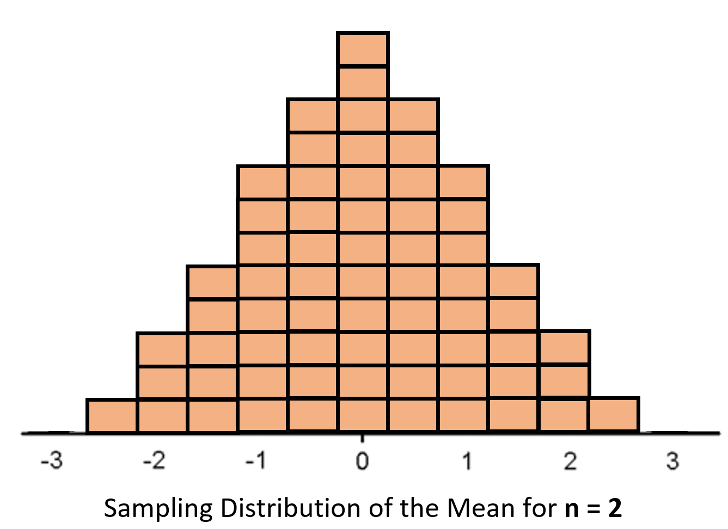
Sampling Distribution of the Mean
Mean (x̅) Values
A sampling distribution is all possible means and their probabilities
This new probability distribution will be our null distribution
We will compare a sample mean to this null distribution, asking whether the sample fits the null or not

Slide 31
Sampling Distribution of the Mean
Mean (x̅) Values
We can determine three properties of our population from the sampling distribution
Central Tendency
Variability
Shape

Slide 32
Lecture Outline
Distributions of Hypothesis Testing
Defining the Sampling Distribution

Slide 33
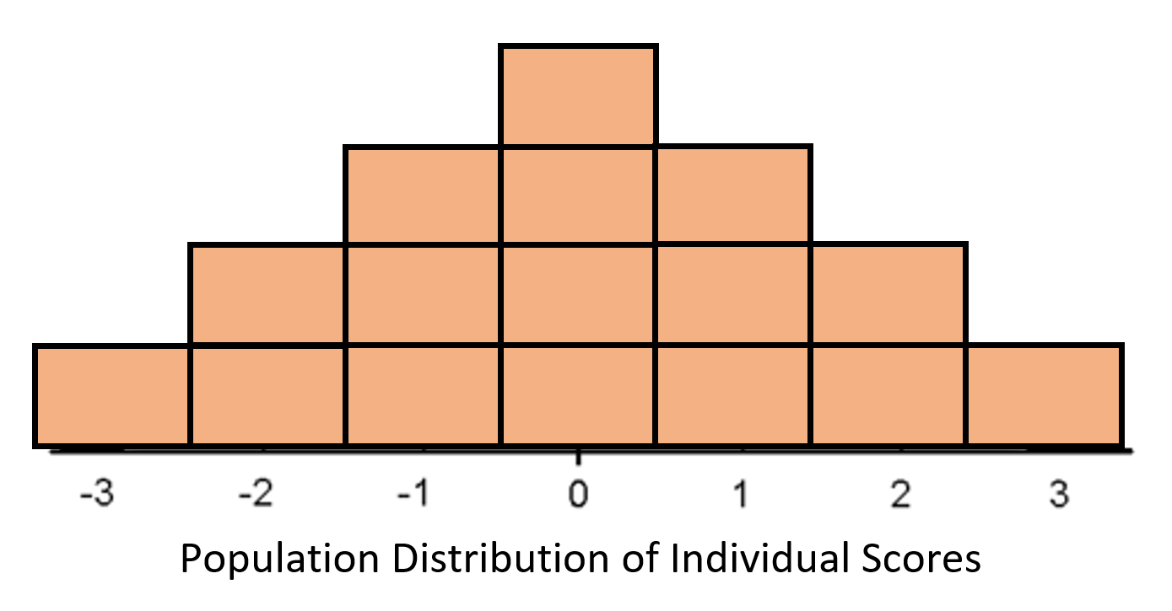
Estimation Central Tendency
Central Tendency: We estimate the mean
The average of our means (μ_{x̅})
The mean of the sampling distribution (μ_{x̅}) will be the same as the mean of the population (μ)
μ_{x̅} = μ
This is true because:
All possible means are included
Each sample is randomly pulled from the population
Doing this enough times will ensure that the population is accurately represented

Slide 34
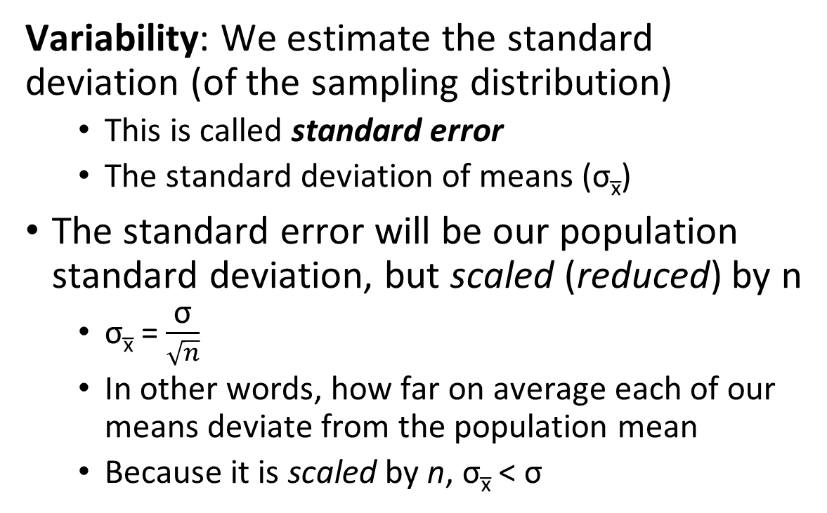
Estimation Variability
Variability: We estimate the standard deviation (of the sampling distribution)
This is called standard error
The standard deviation of means (σ_{x̅})
The standard error will be our population standard deviation, but scaled (reduced) by n
σ_{x̅} = $\frac{\text{σ}}{\sqrt{n}}$
In other words, how far on average each of our means deviate from the population mean
Because it is scaled by n, σ_{x̅} < $\text{σ}$

Slide 35
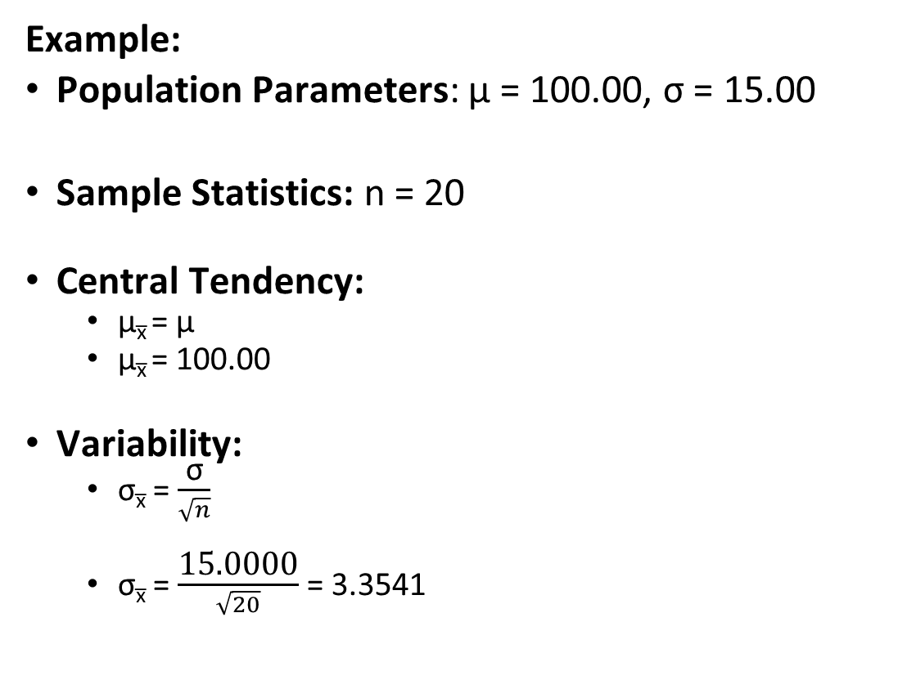
Estimation Example
Example:
Population Parameters: μ = 100.00, σ = 15.00
Sample Statistics: n = 20
Central Tendency:
μ_{x̅} = μ
μ_{x̅} = 100.00
Variability:
σ_{x̅} = $\frac{\text{σ}}{\sqrt{n}}$
σ_{x̅} = $\frac{\text{15.0}\text{00}\text{0}}{\sqrt{20}}$ = 3.3541

Slide 36
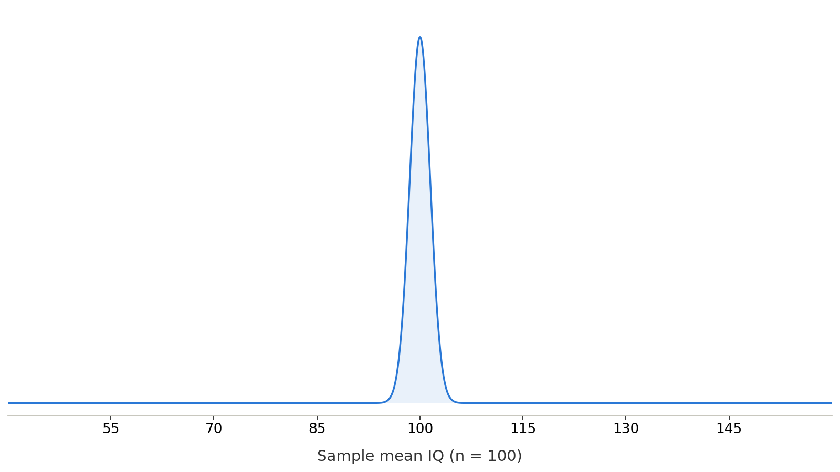
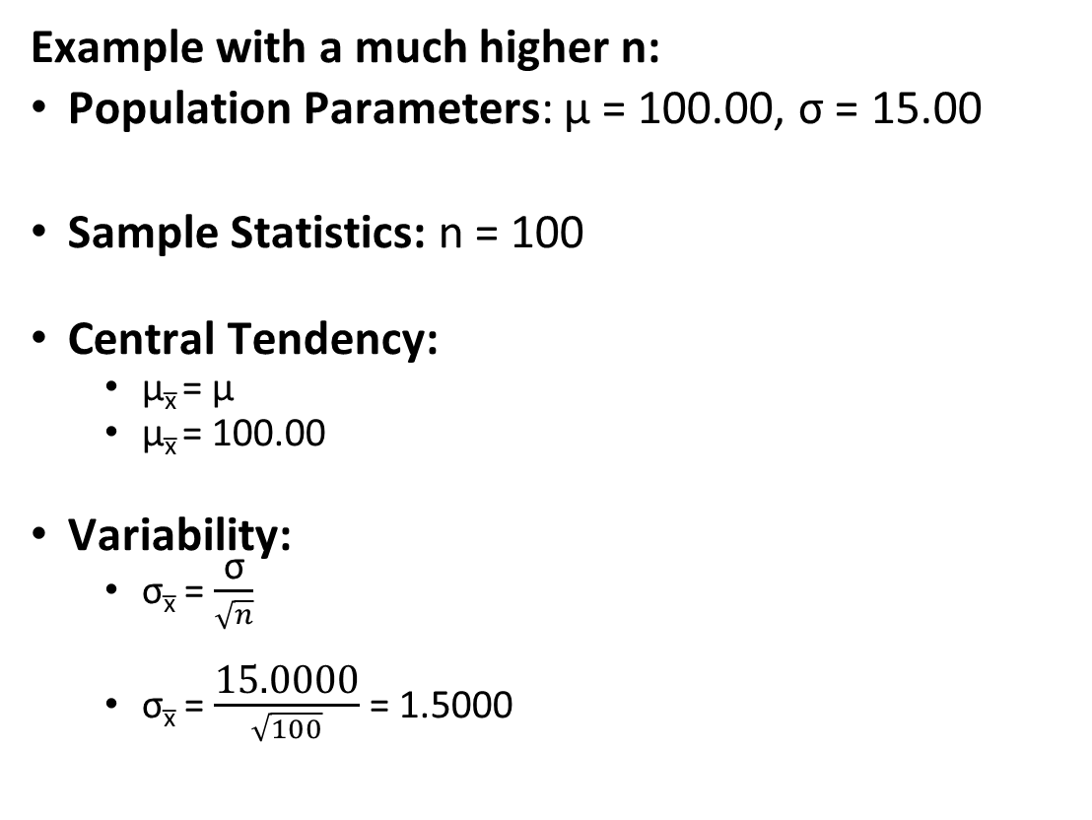
Estimation Example
Example with a much higher n:
Population Parameters: μ = 100.00, σ = 15.00
Sample Statistics: n = 100
Central Tendency:
μ_{x̅} = μ
μ_{x̅} = 100.00
Variability:
σ_{x̅} = $\frac{\text{σ}}{\sqrt{n}}$
σ_{x̅} = $\frac{\text{15.0}\text{00}\text{0}}{\sqrt{100}}$ = 1.5000

Slide 37
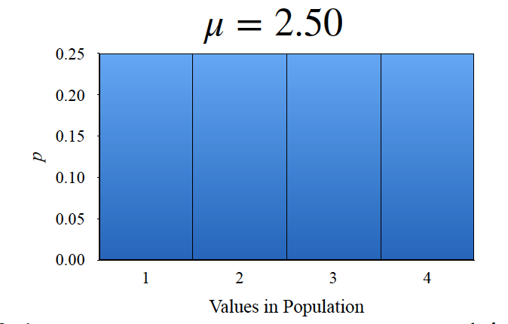
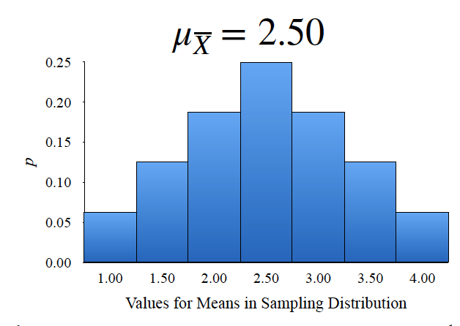
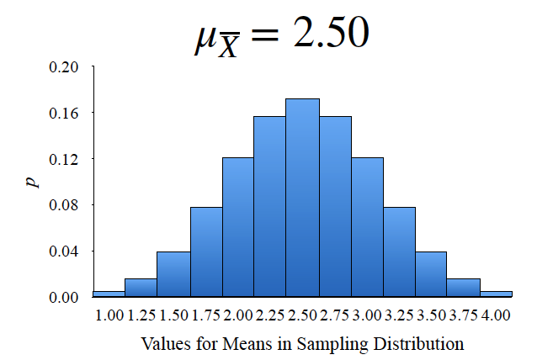
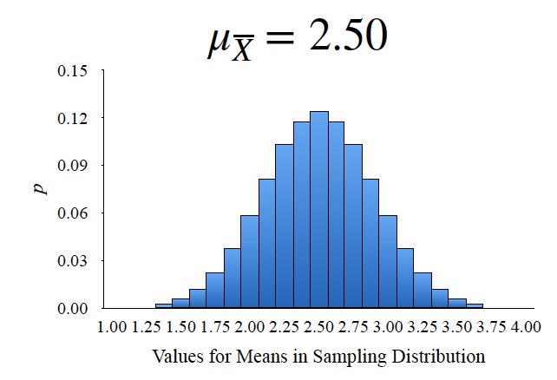
Estimation Shape
Shape: We want to estimate the shape
Shape of the sampling distribution is normal if the population is normal
Central Limit Theorem: As sample size (n) increases, shape of the sampling distribution of the mean becomes normal
We want a normal distribution so we can use the standard normal distribution
n = 2
n = 4
n = 8

Slide 38
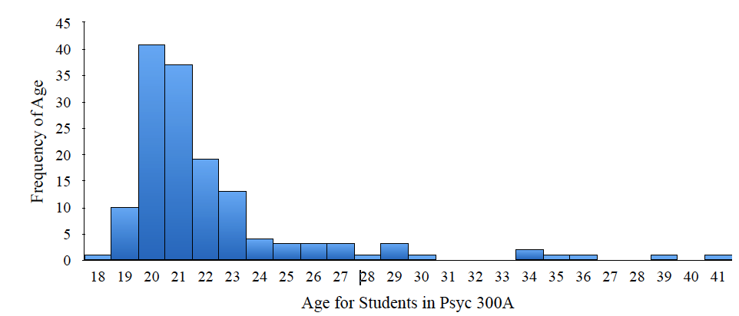
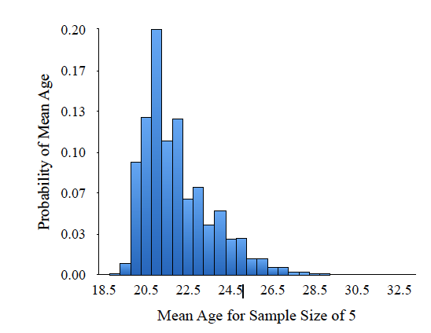
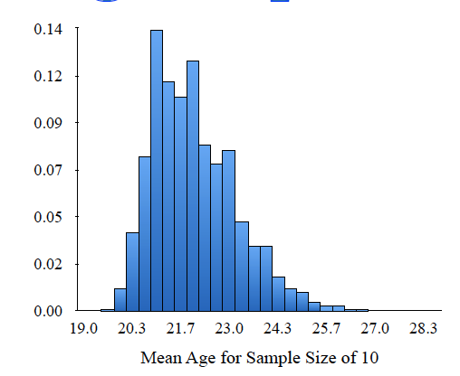
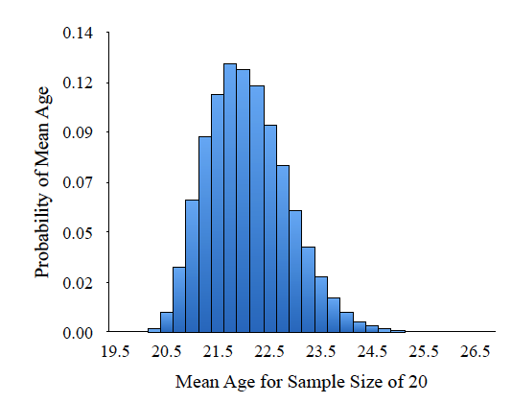
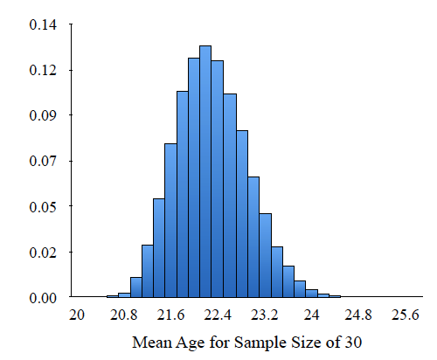
Sampling Distribution of the Mean
Shape: We want to estimate the shape
Central Limit Theorem: As sample size (n) increases, shape of the sampling distribution of the mean becomes normal
This occurs no matter the shape of the sample
n = 5
n = 10
n = 20
n = 30

Slide 39
Sampling Distribution of the Mean
Required n to make skew normal
Mild skew: n = 10+
Moderate skew: n = 18+
Strong skew: n = 25+
Shape: We want to estimate the shape
Central Limit Theorem: As sample size (n) increases, shape of the sampling distribution of the mean becomes normal
This occurs no matter the shape of the sample
n = 5
n = 10
n = 20
n = 30

Slide 40

n and our estimates
How does n affect our central tendency, variability, and shape?
Mean: $\text{μ}\text{x}̅$ is unaffected by n
Standard Error: σ_{x̅} decreases with n because $\frac{\text{σ}}{\sqrt{n}}$
Shape: Approaches normal with increasing n
n = 2
n = 4
n = 8

Slide 41
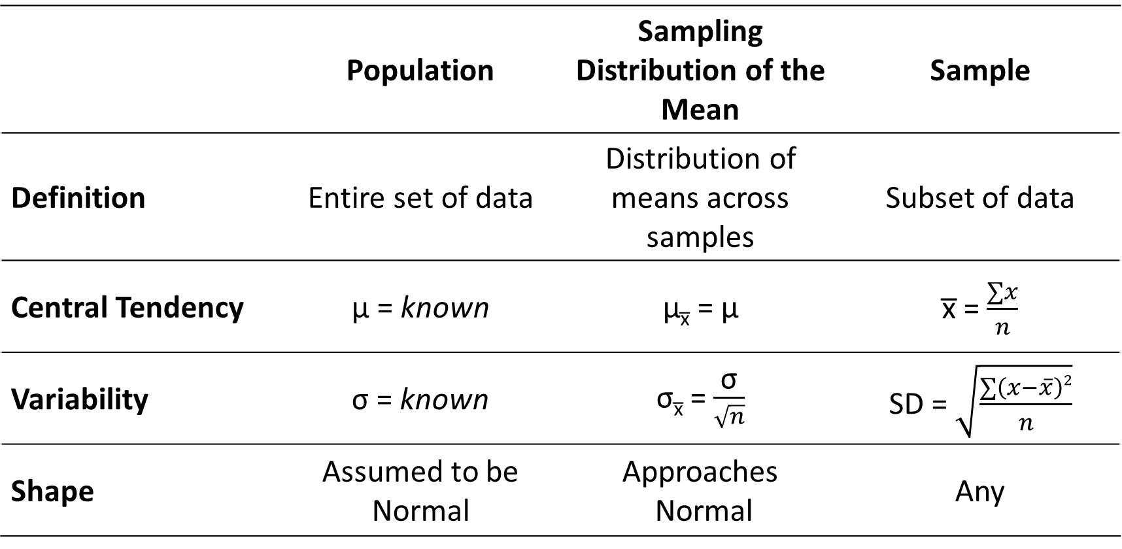
Distribution Equations
 | Population | Sampling Distribution of the Mean | Sample
Definition | Entire set of data | Distribution of means across samples | Subset of data
Central Tendency | μ = known | μ_{x̅} = μ | x̅ = $\frac{∑x}{n}$
Variability | σ = known | σ_{x̅} = $\frac{\text{σ}}{\sqrt{n}}$ | SD = $\sqrt{\frac{∑\left(x−\overline{x}\right)2}{n}}$
Shape | Assumed to be Normal | Approaches Normal | Any

Slide 42
Naming the Sampling Distribution
Sampling distribution of the mean for n = 2 when population parameters are known
What statistic we are building?
Here, we did the mean
What sample size are we using?
Here, we used n = 2
But it can be anything n > 1
Are population parameters known?
Here they are known
We will see examples later where they are unknown (Unit 4.3.)

Slide 43
Hypothesis Testing and the Sampling Distribution
Type of Research Design | Single Sample Design
Model of Hypothesis Testing | Random Sampling
Nature of Data | Score data
Statistic Being Analyzed | x̅
Information of Population | μ = 100.00, σ = 15.00
Sample Size | n = 20
Shape | Normally Distributed
Sampling Distribution | Sampling Distribution of the Mean when n = 20 and population parameters are known

Slide 44
Extra Resources

Slide 45
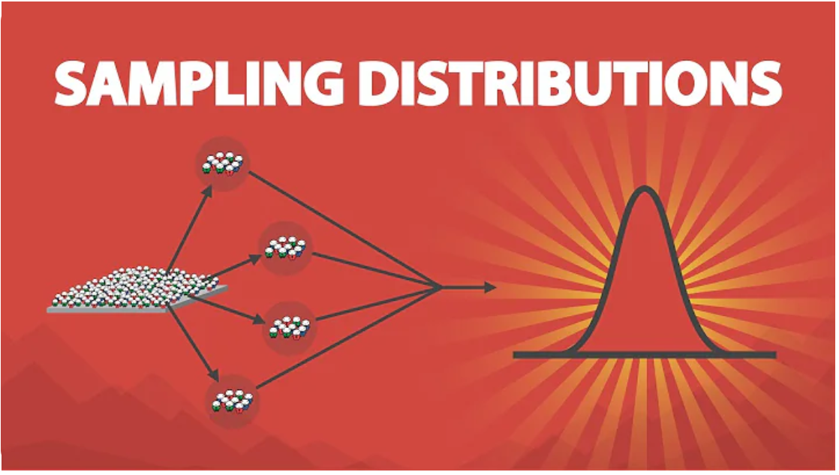
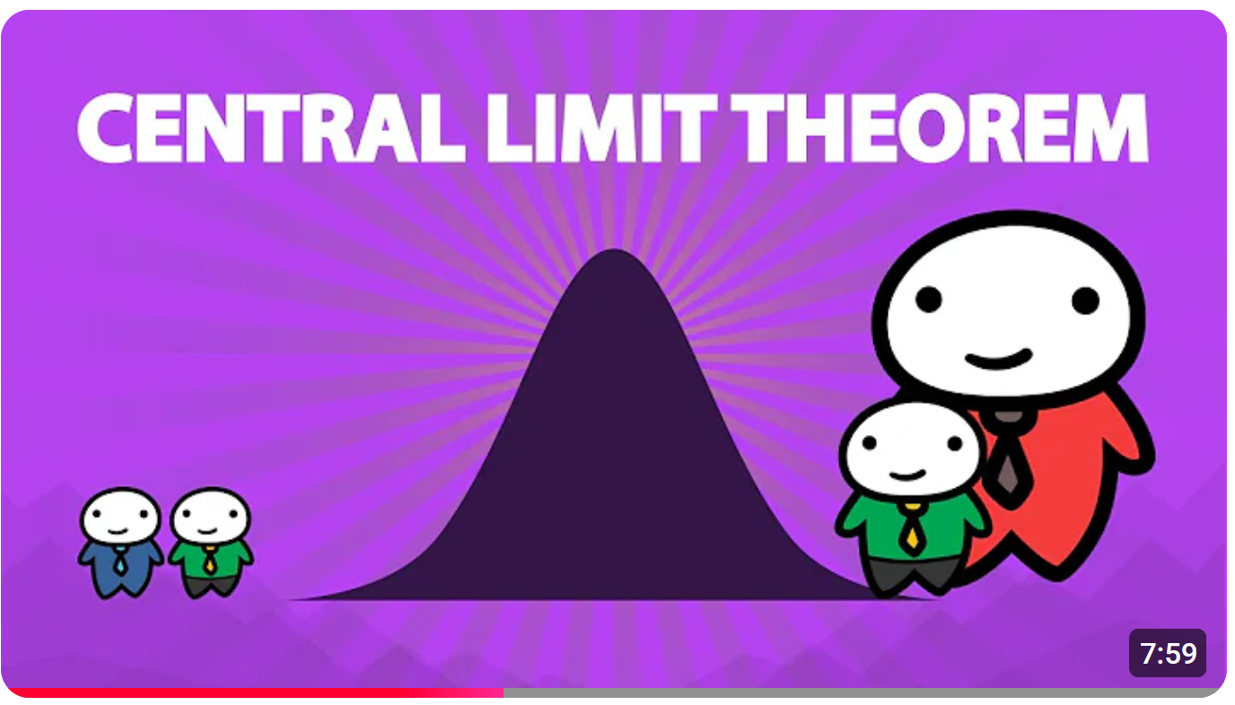
Extra Resources

